Slide 1

React 101 2024 An introduction workshop

Slide 2



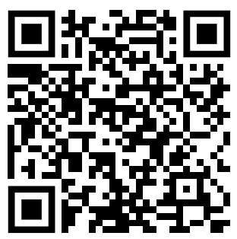
Peter Eijgermans
@EijgermansPeter
Peter Eijgermans
@EijgermansPeter

Slide 3
Agenda
Adding forms and validation
Adding forms
Use effect
Day 1
What is React and how to get started
Working with HTML in React
Working with Routing
Component state management
Sharing state (props)
Showcasing city (exercise)
Day 2

Slide 4
What is React?

Slide 5
What is React
React.js is commonly used for creating SPA. it focusses on the following main characteristics.
Component based architecture.
Interactive User interfaces.
Virtual Dom.

Slide 6
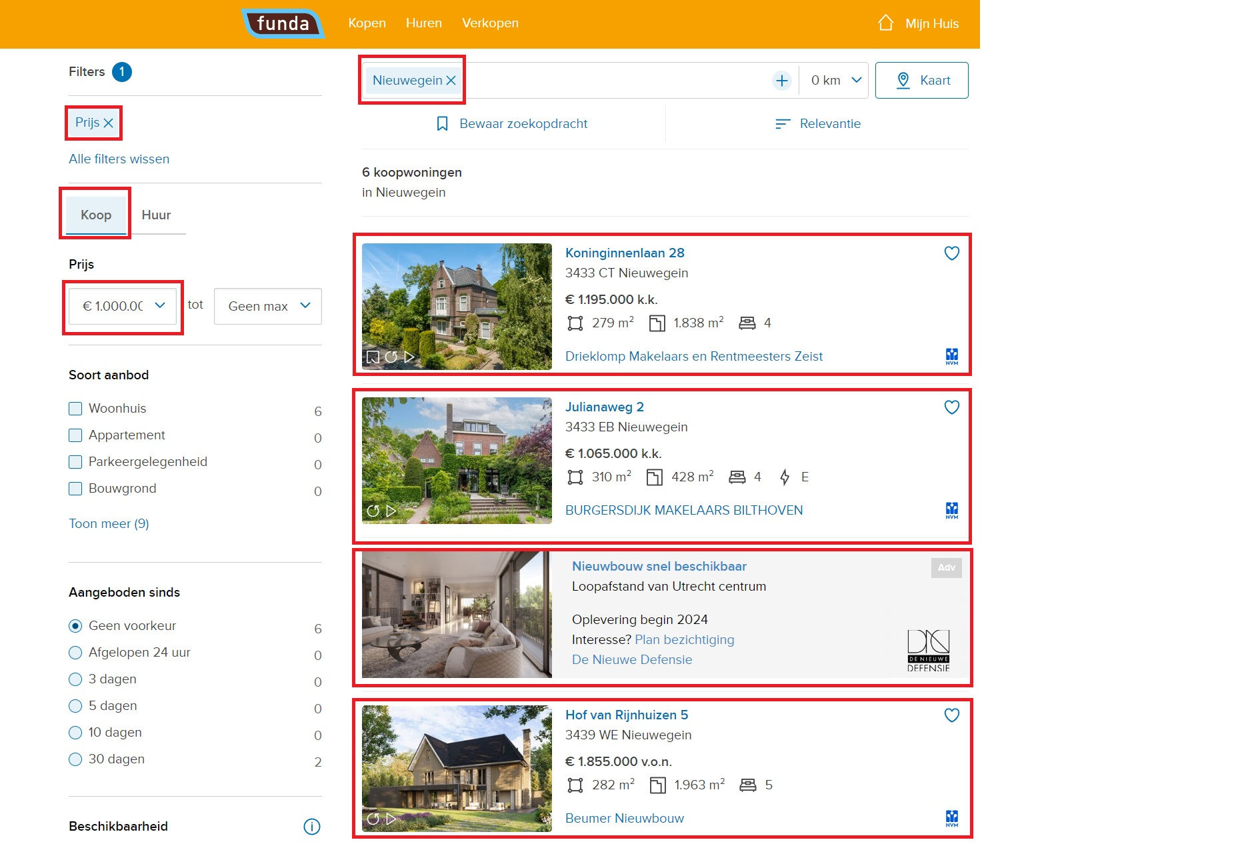
Component based architecture

Slide 7
Interactive User Interfaces
React is used to create interactive UIs with ease and speed. React will efficiently update and render just the right components when data changes. Making it easier for developers to focus on their creativity.

Slide 8
Virtual DOM
React uses a virtual DOM, which is a lightweight copy of the real DOM. It allows React to efficiently update the DOM by comparing the current state of the UI with the new state and making only the necessary changes.
Virtual dom explained

Slide 9
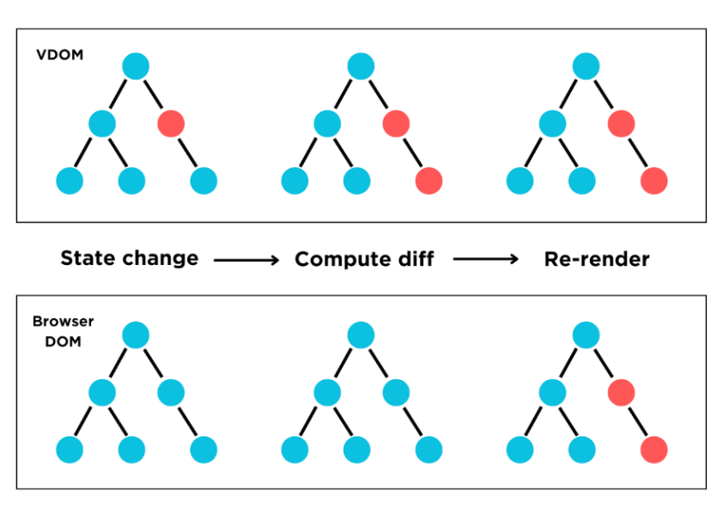
Virtual DOM

Slide 10
What is React
React.js is a free and open-source front-end JavaScript library for building user interfaces based on components.
It is maintained by Meta (former Facebook) and a community of individual developers and companies

Slide 11
Getting started

Slide 12
Getting started
There are 2 common options to get started with React.
Create-React-app
Vite

Slide 13
Getting started
In this workshop we will make use of Vite to enable us with faster and better build tools. To get started please run the command below in your preferred directory.
‘ npm create vite@latest ‘

Slide 14
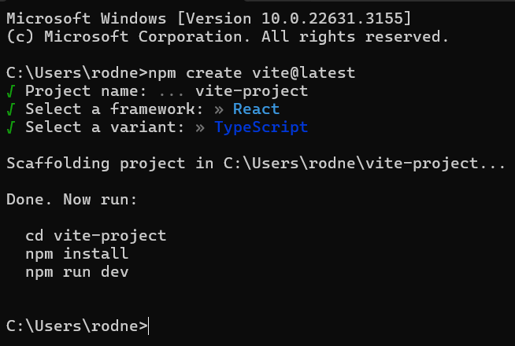
Getting started
If everything goes correctly, we now see the following screen. Follow the prompts listed in the cli.

Slide 15
Getting started
To see the actually application please run:
‘ npm run dev‘

Slide 16
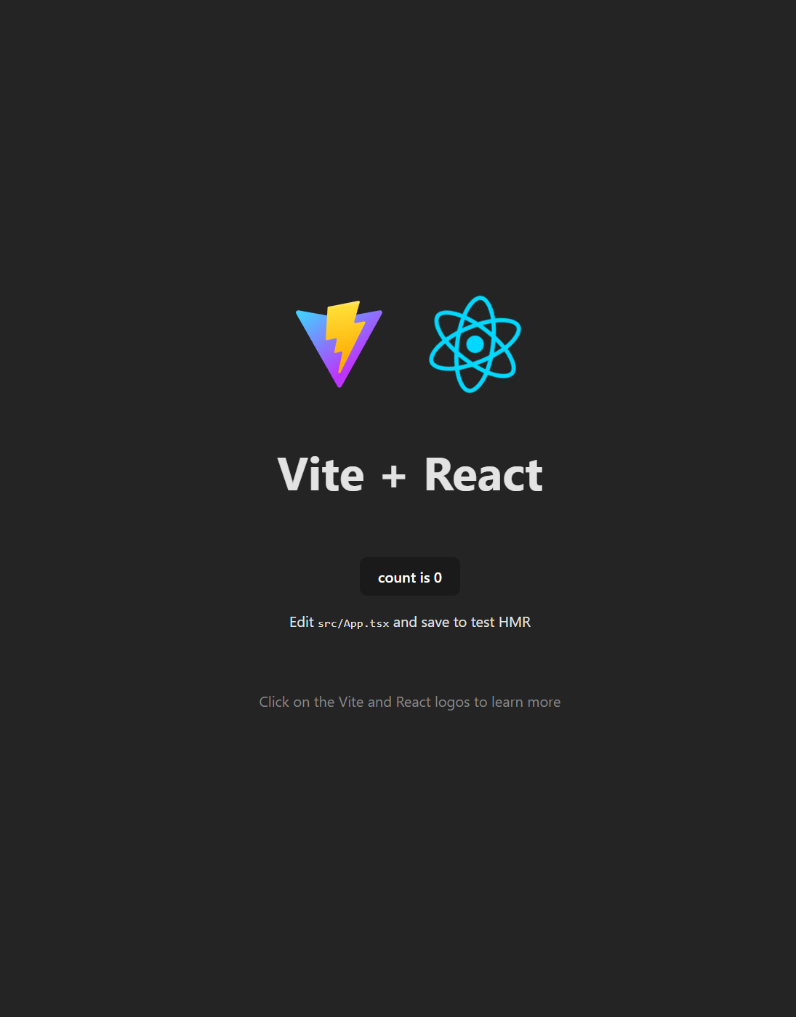

Slide 17
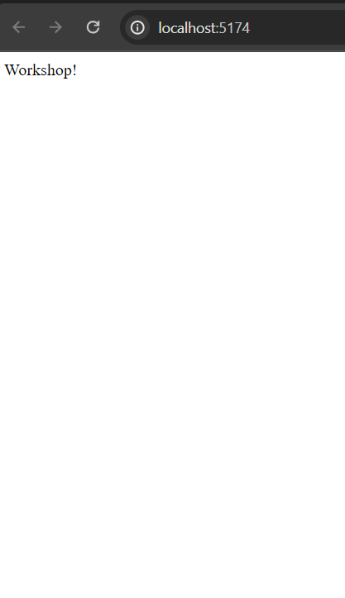
Getting started
Let’s remove all the boilerplate code and also remove the imports.

Slide 18
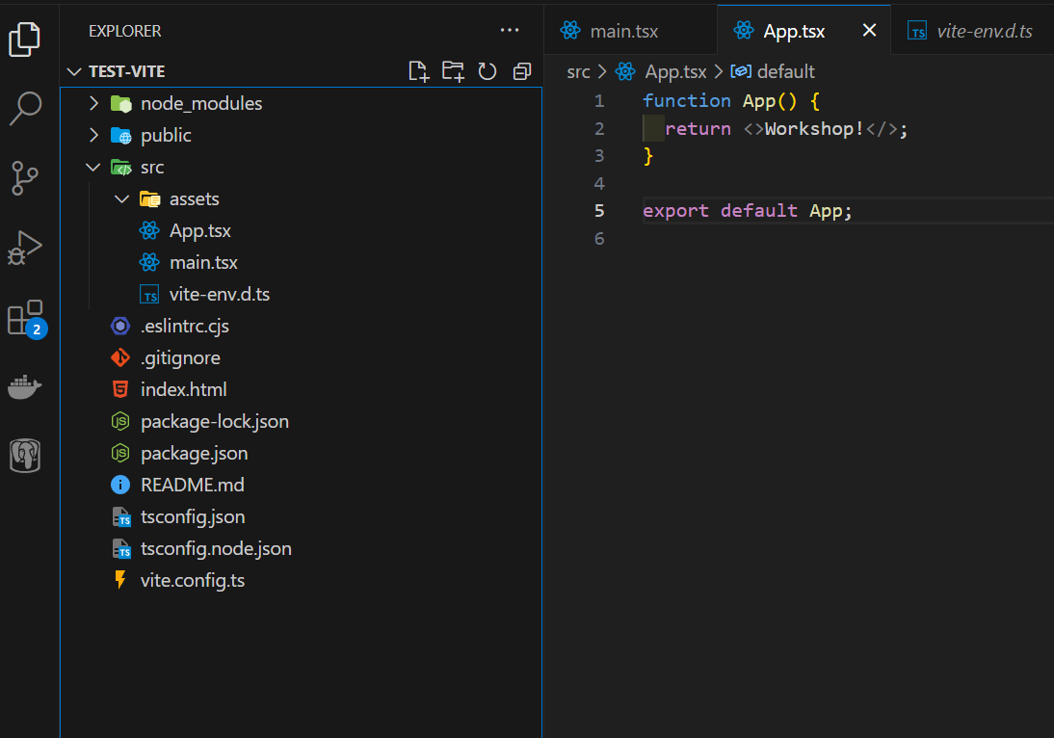

Slide 19
Getting started
Sometimes we want to be able to customize our ports for development and production build. In Vite this can be done within the “./vite.config.ts” file.

Slide 20
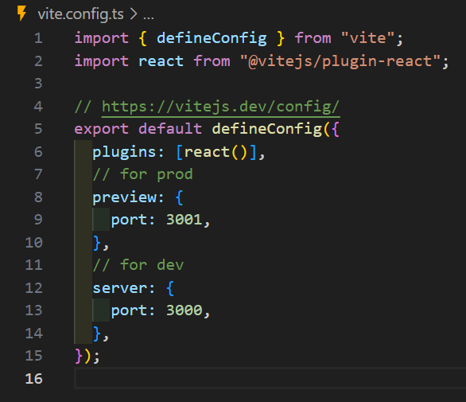

Slide 21
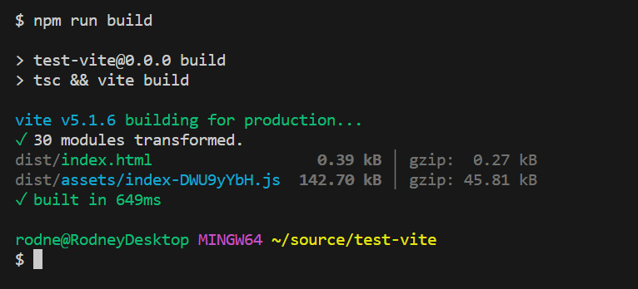
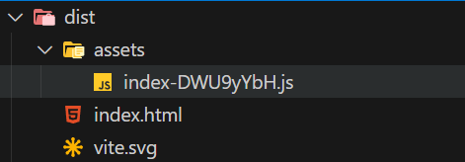
Getting started
Up until now we have been running a dev build. For production we want to make sure we use a production build. When run correctly, it will create a dist folder. Let’s run “ Npm run build “

Slide 22
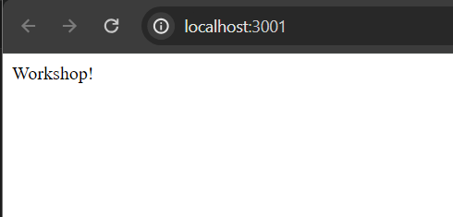
What is React
In JavaScript. Production builds will make sure all code is minified and optimized to reduce load times as much as possible. To preview our application, we can use the command: “ npm run preview ”

Slide 23
Working with HTML in React

Slide 24
HTML in React
In React all files that use HTML needs to have a filename called JSX. This stands for JavaScript extended. It enables us to use inline HTML in JavaScript. It might take some time to get use to, but really enables developers to move fast.

Slide 25
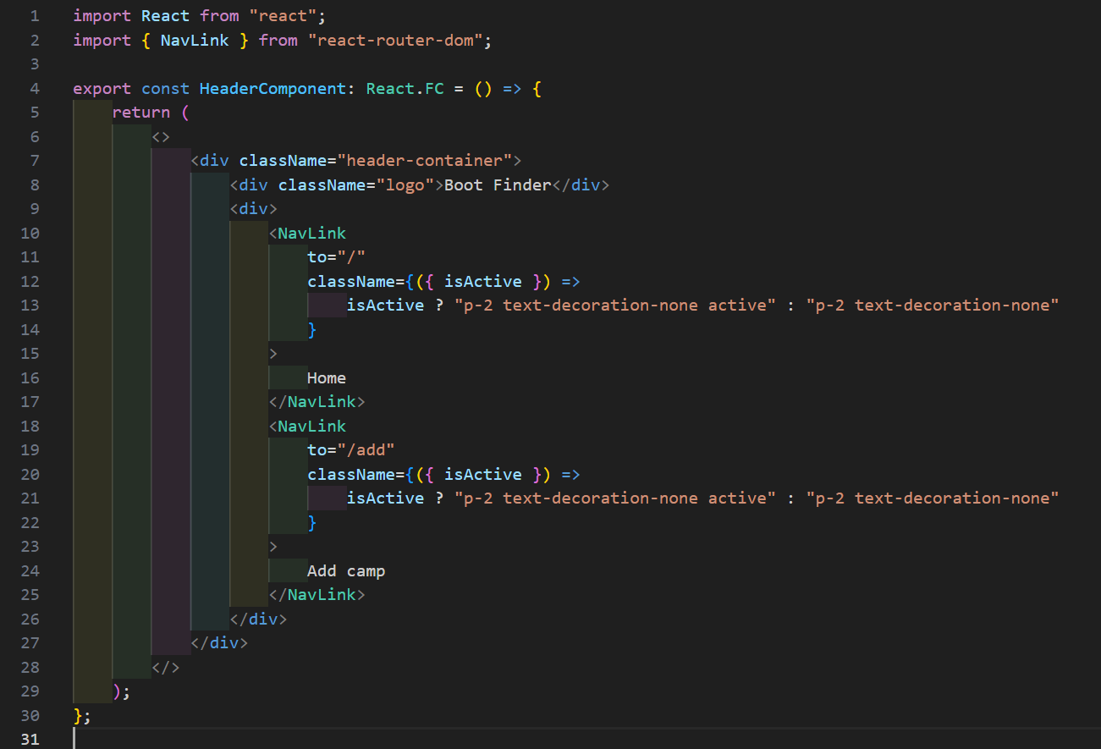

Slide 26
HTML in React
JSX have a couple rules that we must adhere to:
HTML must always be enclosed with () brackets when multiline.
It can only have 1 parent element per component.
Every list must have a key identifier.
Some HTML attributes are named different to prevent collision with the JavaScript namespace. Class => className, for => htmlFor.

Slide 27
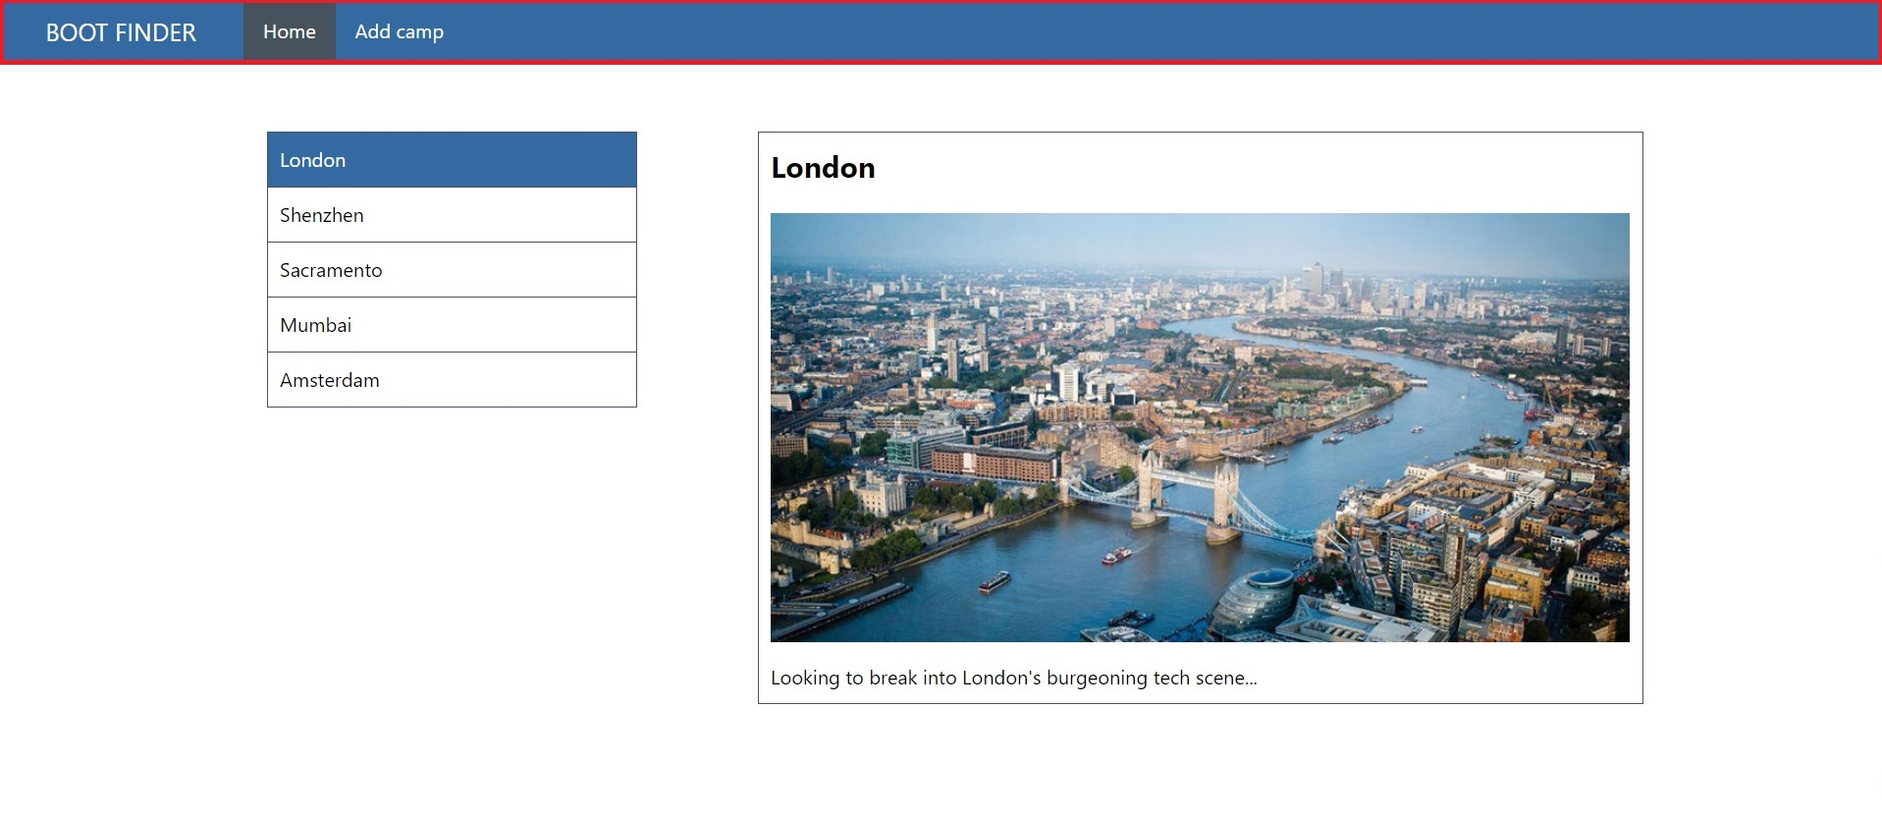
HTML in React
Let’s get started writing our first component. We will create the top navigation for the page. Create “ src/components/HeaderComponent/HeaderComponent.tsx ”

Slide 28
HTML in React
Let’s create our first functional component in the “./src/components/headerComponent/HeaderComponent.tsx file. And import it into our “./App.tsx” file.

Slide 29
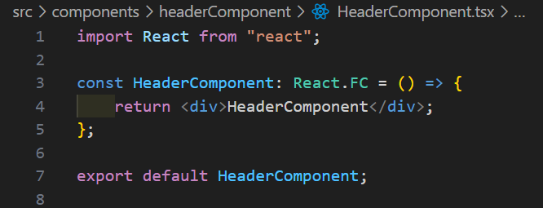
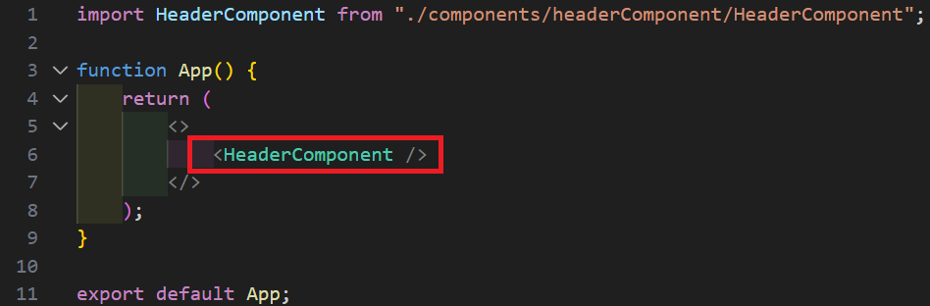

Slide 30
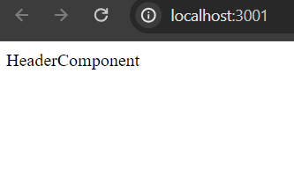
HTML in React
When running in the browser you will see:

Slide 31
HTML in React
Let’s import our styling which I have already prepared for you. You can download it at. https://github.com/rwormsbecher/react-ts/blob/main/src/index.scss Place the scss file in “./src/index.scss”. And add an import in App.tsx. Furthermore, to be able to use scss we need to install Sass. Pleas run: “ npm I sass ”

Slide 32
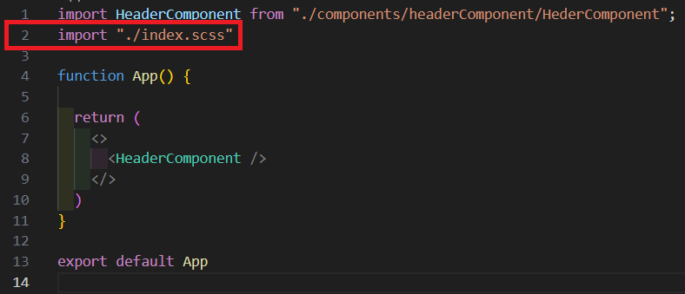

Slide 33
HTML in React
Let’s add some HTML and classes to the HeaderComponent. Since the styling is already there, we will only care for the HTML.

Slide 34
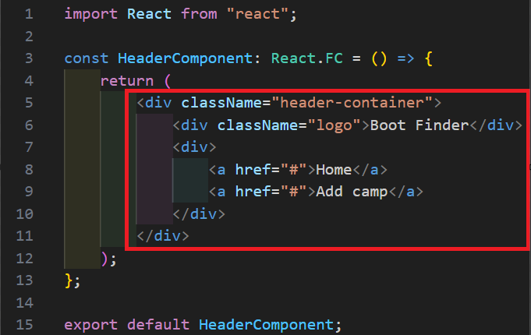

Slide 35
HTML in React
To wrap up this chapter we will make 2 more components. “./src/pages/Homepage.tsx” and “./src/pages/Addpage.tsx”. Make sure both components show a text and load it in the AppComponent.

Slide 36
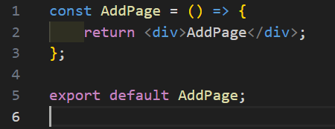
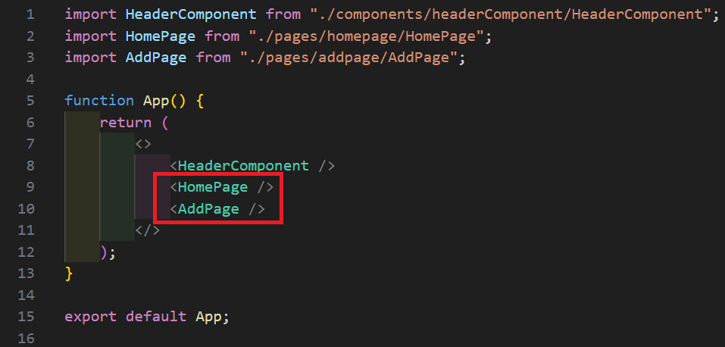
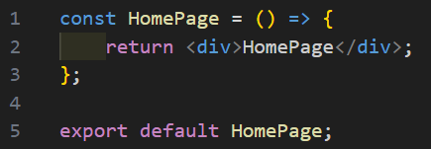

Slide 37
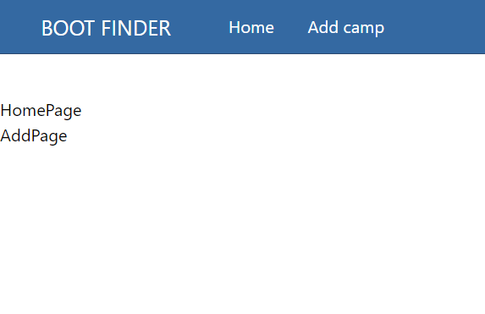
What is React

Slide 38
React Routing

Slide 39
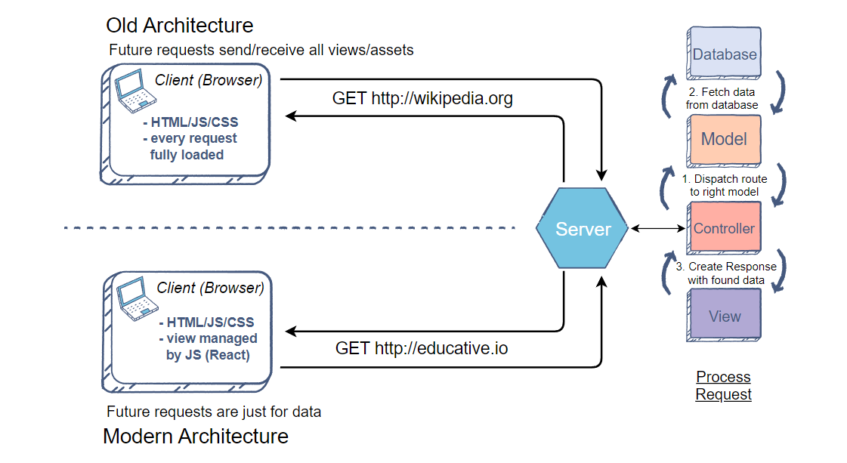
What is React
Routers in SPA allow us to navigate within the application, but without full page reloads.

Slide 40
How to React Router
To use react-router-dom we will first need to install it.
Run: “ npm I react-router-dom”. After that we will need to do 3 things:
Wrap our applications with “BrowserRouter” to mark where our router starts.
Create a router outlet in which we specify where a route leads to.
Create links that will hook up our urls with the router-outlet.

Slide 41
React Router step 1
Let’s start with step 1. Add the BrowserRouter in “main.tsx”
And install : npm i react-router-dom

Slide 42
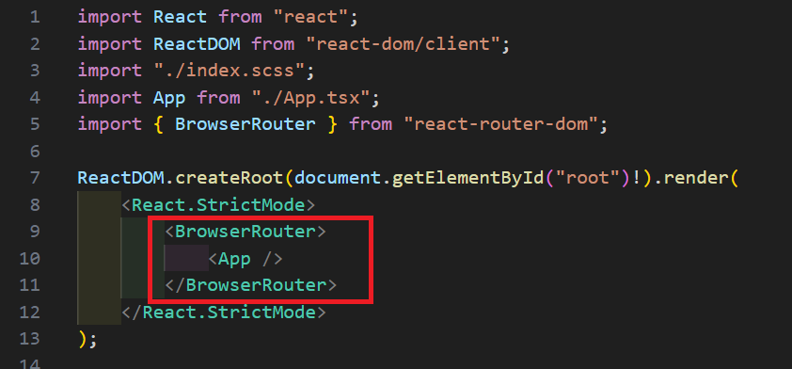

Slide 43
React Router step 2
Next, we create a “router outlet” in which we can specify which components will be shown when a particular uri is given.

Slide 44
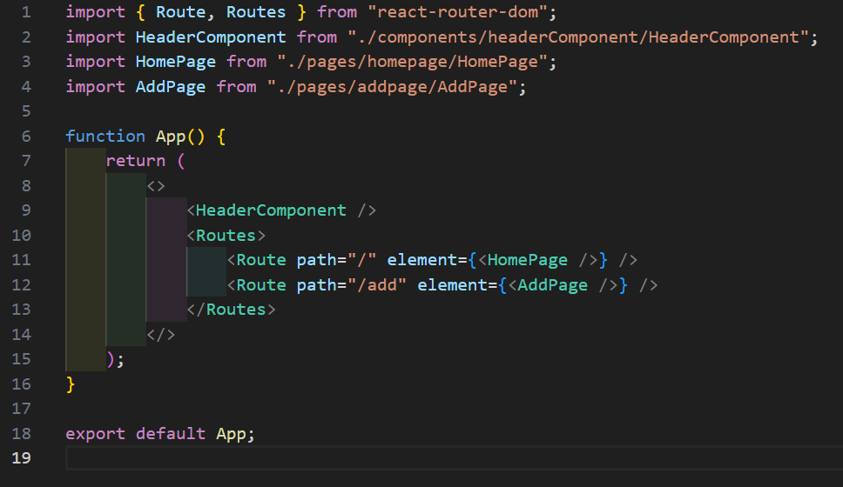

Slide 45
React Router step 3
Lastly, we need to adjust the links in the HeaderComponent. This can be done by using a “Navlink” element form “react-router-dom”.
https://reactrouter.com/en/main/components/nav-link

Slide 46
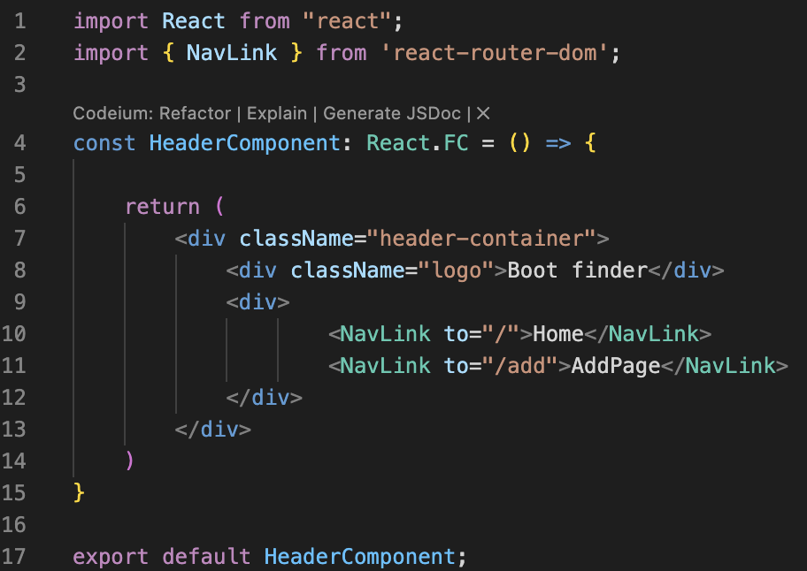

Slide 47
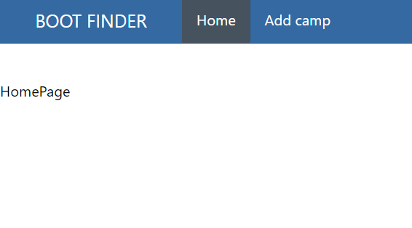
What is React
If everything went correctly, we can now see our router.
https://reactrouter.com/en/main/components/nav-link

Slide 48
Component state

Slide 49
Understanding State
Every component-based frontend framework contains a basic way to pass state between components. Let’s first look at the react component lifecycle.

Slide 50
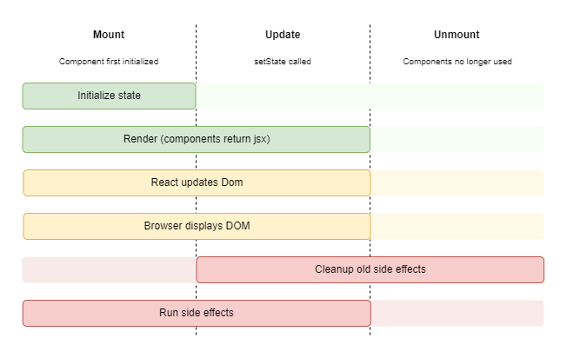
Understanding State lifecycle

Slide 51
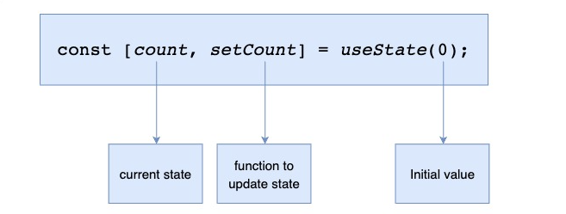
Understanding State
To create state we can use “useState” within React.

Slide 52
Understanding State
It is of uttermost importance to realize that the array has a getter and a setter. Which one is right?
count = 20
setCount = 20
setCount(20)

Slide 53
Understanding State
For now, we will make use of dummy data for the cities, later we will fetch the data from an API. Create a file “src/cities.json” and copy the following contents:
cities.json

Slide 54
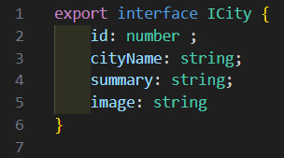
Understanding State
As we are using typescript, we first want to create a model describing our cities dummy json data. Create the file “src/models/ICity.ts”.

Slide 55
Understanding State
Now let’s create our first piece of state and render it on the screen just below the router-outlet.

Slide 56
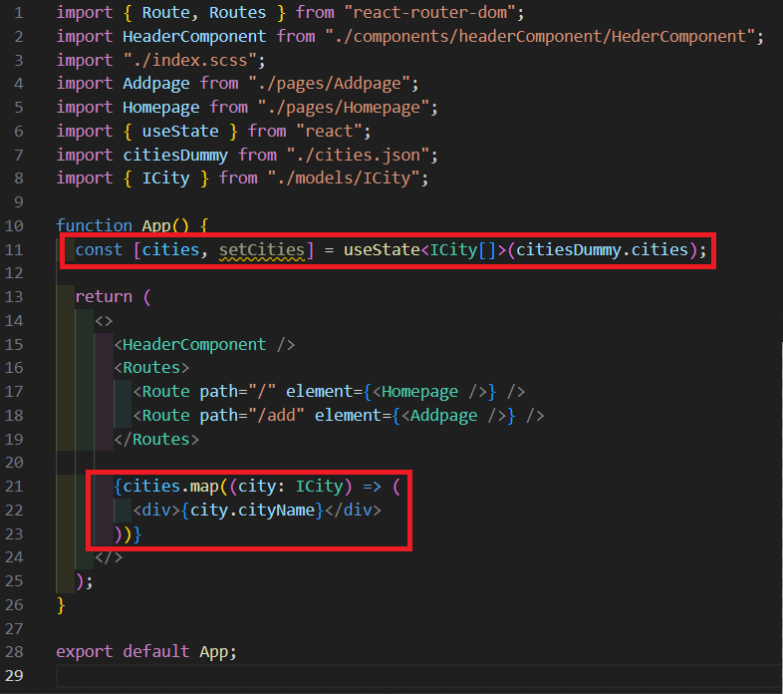

Slide 57
Understanding State
We need to be able to select a city. For that we will create a second piece of state called “activeCity”

Slide 58
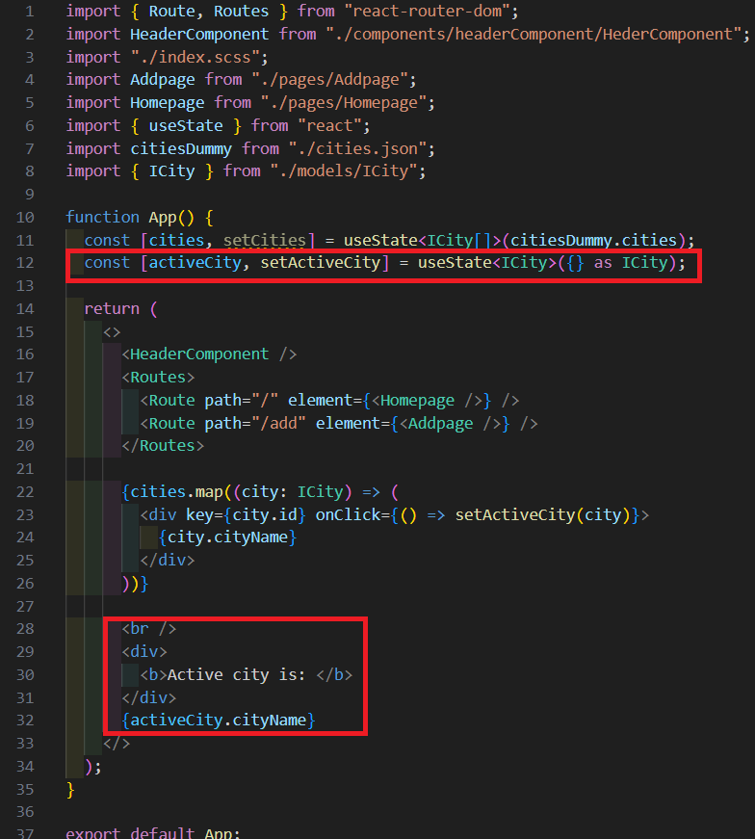

Slide 59
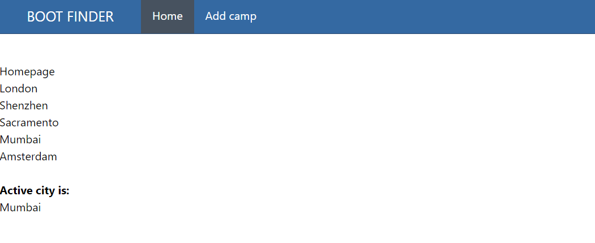
Understanding State
If everything went correctly you can now select and render a city on the screen.

Slide 60
Understanding State
Now that we have state in place, we would like to create a new component to display our navigation in a nicely ordered list. To do that we need to pass our state into the child component. Let’s take a look at that next.

Slide 61
Share state as props

Slide 62
Understanding State
When a parent component pass down it’s state to a child component is called “props” in the receiving child component.

Slide 63
Understanding State
We need to do 3 things to send state down as props.
The parent component must pass an attribute containing the state
The receiving component needs to describe the signature of the props.
The receiving component needs to take the props as function parameters.

Slide 64

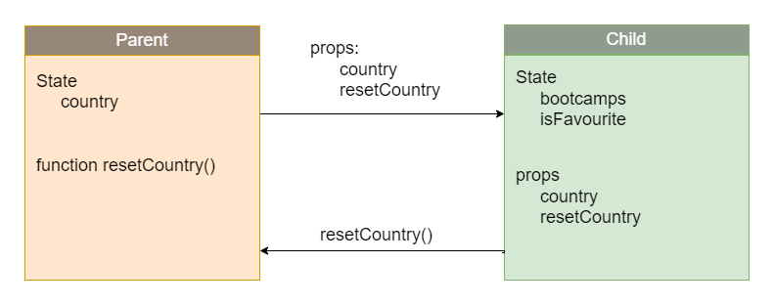
Understanding State
React:
Country state and function gets send to child
Country state and functions gets send down to child the second time
Function is executed and updates country state
Function gets called in child
Function returns to parent “execution context”

Slide 65
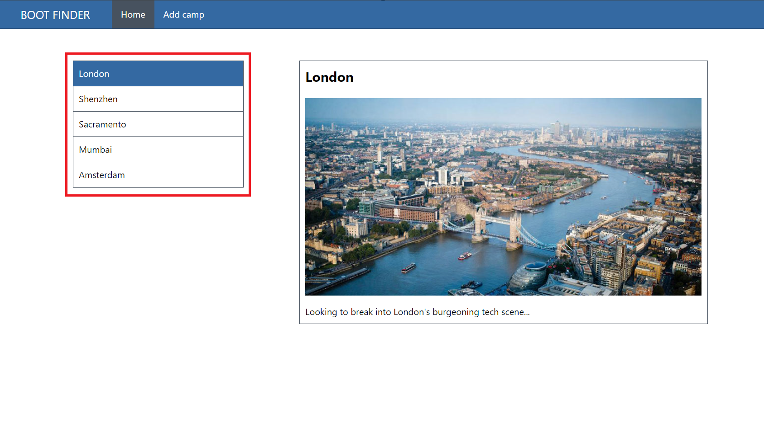
Understanding Props
In this section we will build the left navigation

Slide 66
Understanding Props
Let start off making a new component:
“src/components/ListComponent/ListComponent.tsx”

Slide 67
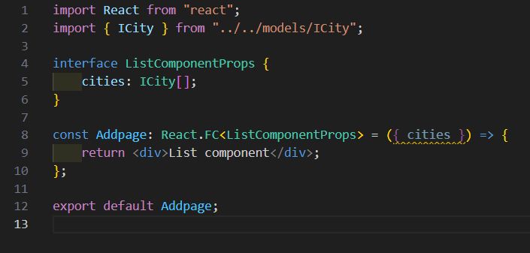
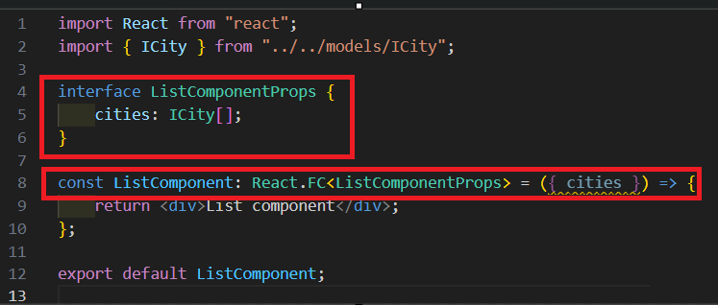

Slide 68
Understanding Props
We need to pass our cities state from App.tsx to Home.tsx to ListComponent.tsx. Let’s start:

Slide 69
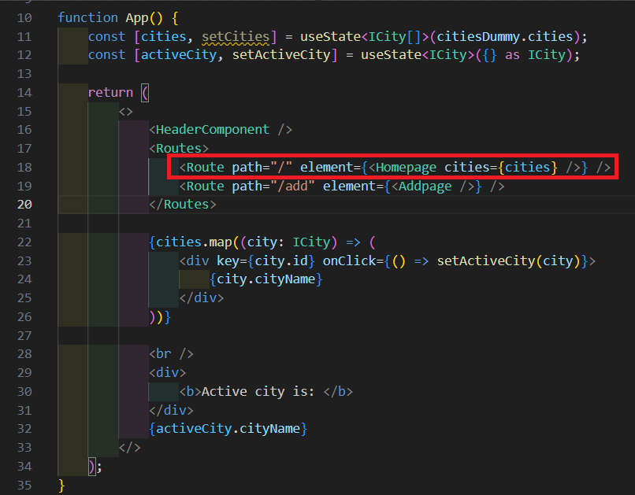

Slide 70
Understanding Props
Next, we want to receive the props in The Homepage and send this to the ListComponent component.

Slide 71
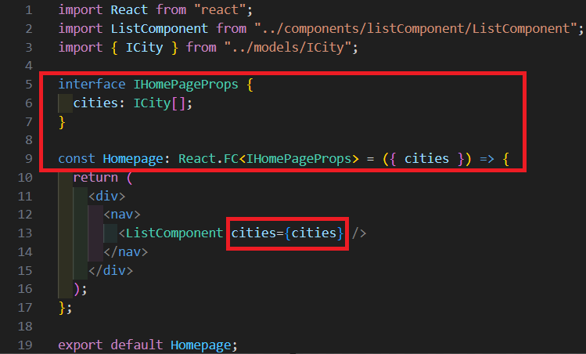

Slide 72
Understanding Props
In the ListComponent we can now receive the props and use it for rendering the list of items.

Slide 74
Understanding Props
Let’s add the rendering.

Slide 75
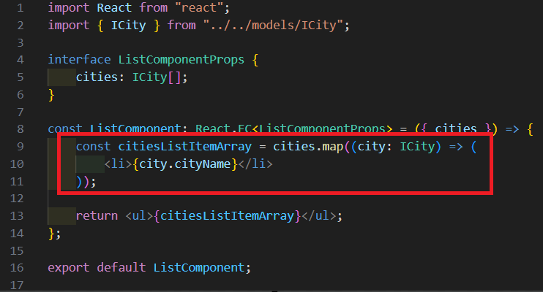

Slide 76
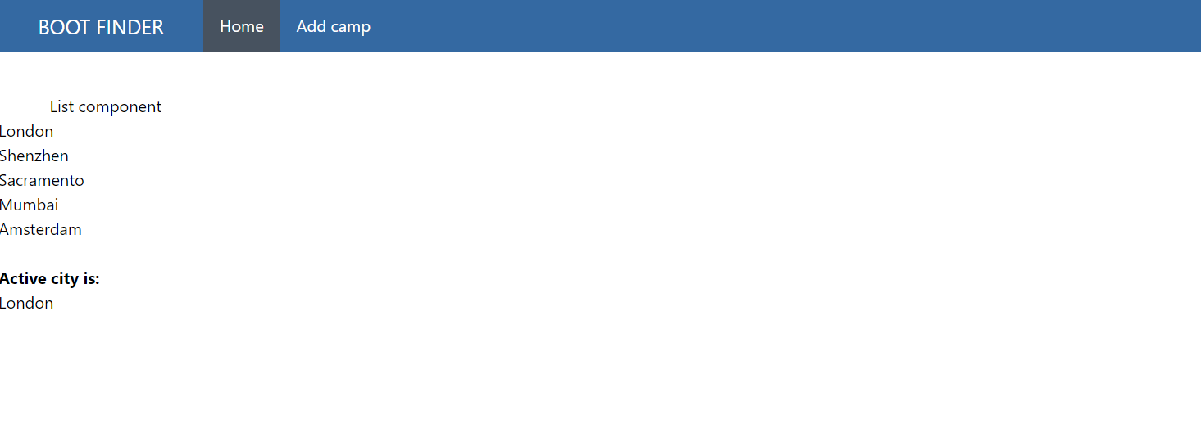
Understanding Props

Slide 77
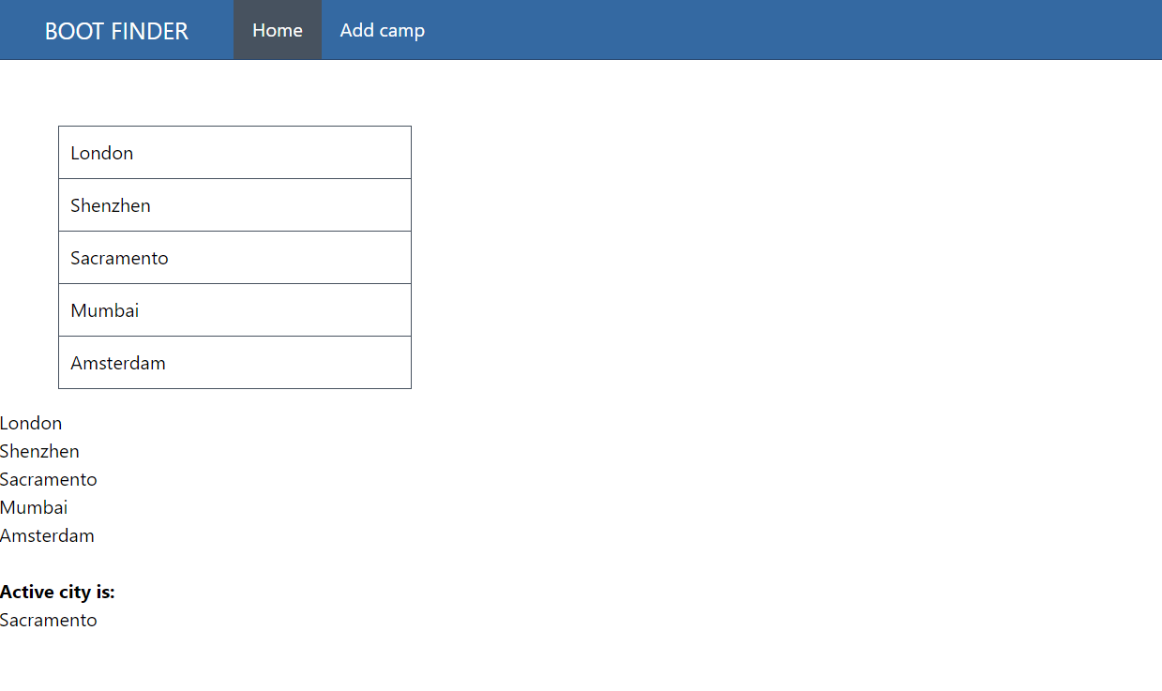
Understanding Props

Slide 78
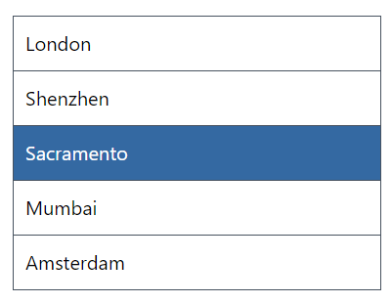
Understanding Props
As an exercise try to display the active state as in the picture below.

Slide 79
Understanding Props
To achieve this, you will need to:
Pass state as props
Dynamic classname “active-city”
invoke a function to update the active city.

Slide 80
Understanding Props
First pass the “activeCity” and “setActiveCity” to the Home component.

Slide 81
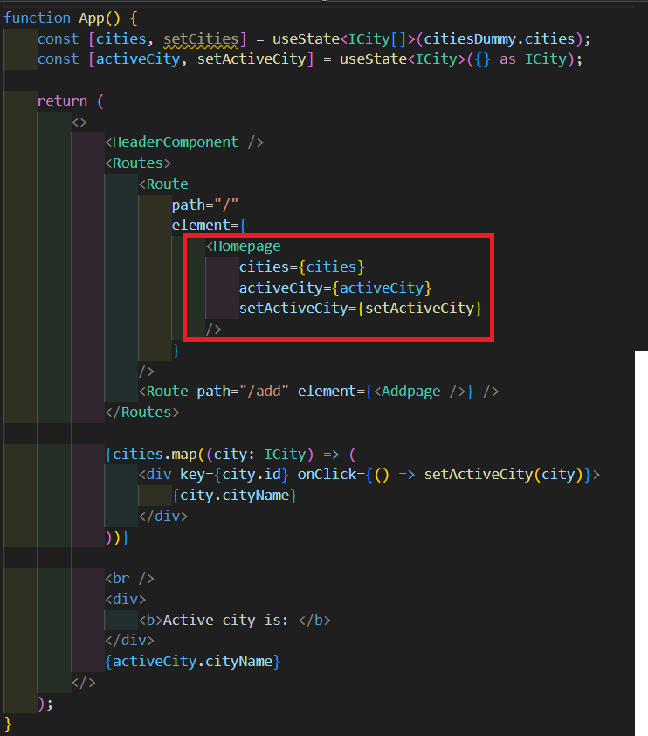

Slide 82
Understanding Props
Next, we pass them from the home component to the ListComponent.

Slide 83
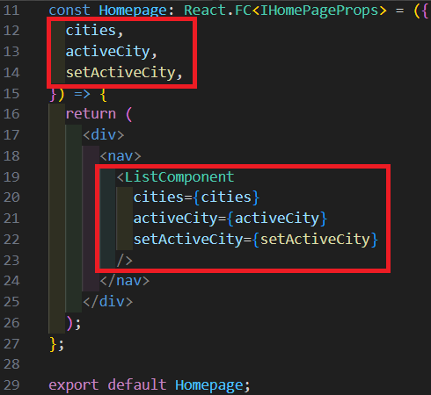

Slide 84
Understanding Props
Then we use the to set the active city and see if it needs the “active-city” class.

Slide 85
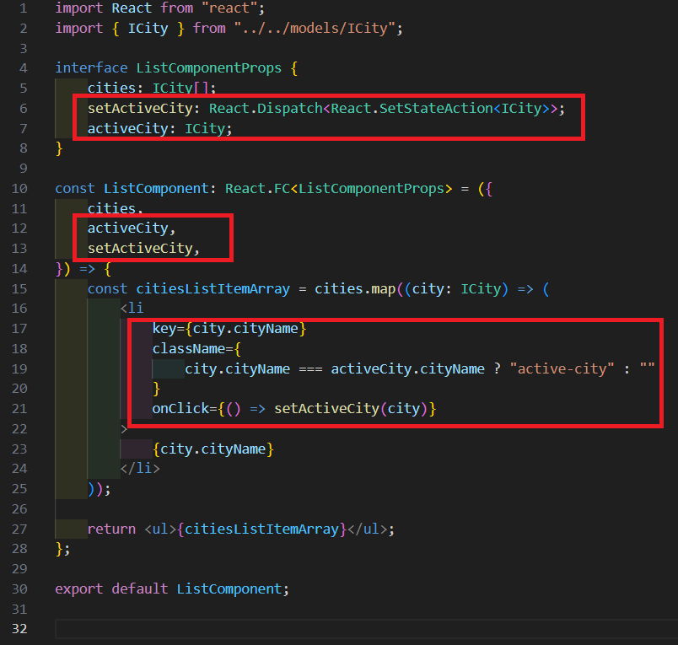

Slide 86
Showcasing city

Slide 87
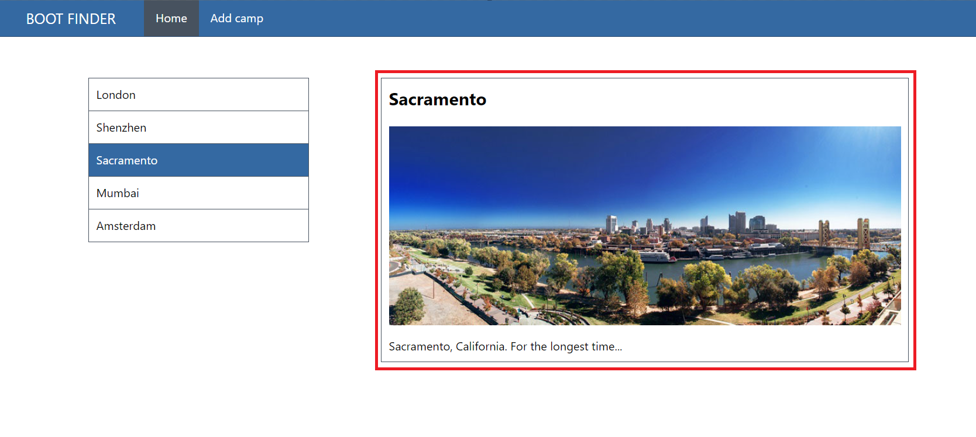
Understanding Props
In this chapter we will work on the Showcase area in the application.

Slide 88
Understanding Props
The showcase component consists out of techniques that we have already covered before except for the images. You can download the images here: https://github.com/rwormsbecher/redux-training-new/tree/master/src/assets/images

Slide 89
Understanding Props
The images should be placed in “src/assets/images” and can be imported as a variable with the following syntax:

Slide 90
Understanding Props
To be able to complete the exercise you must:
Create a new component
Link it through the homepage
Receive props
Render out the content.

Slide 91
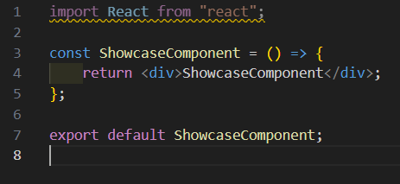
Understanding Props
In “src/components/ShowcaseComponent/ShowcaseComponent.tsx” create a basic component.

Slide 92
Understanding Props
In the “src/pages/Homepage.tsx” import the <Showcase /> component

Slide 93
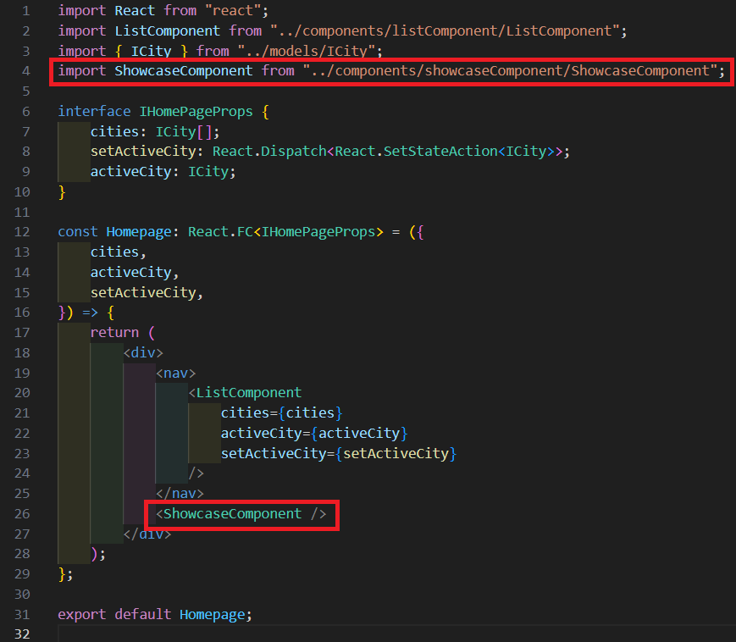

Slide 94
Understanding Props
To add the props we need to define the component’s signature in the <Showcase /> component and pass in the activeCity from the <Homepage /> component.

Slide 95
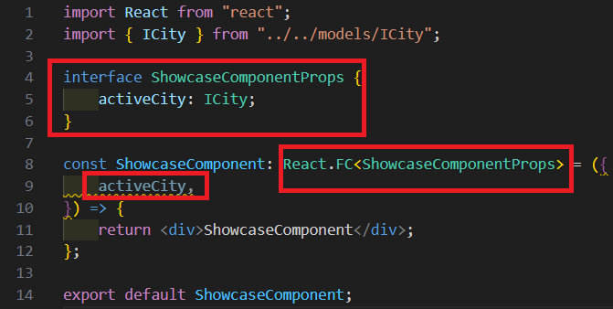


Slide 96
Understanding Props
Last but not least we will render the content of the <ShowcaseComponent />

Slide 97


Slide 98


Slide 99

Understanding Props
If we now load the page everything is working correctly

Slide 100
React forms

Slide 101

What is React
This is what we will be building in this section.

Slide 102
Understanding Props
Forms are the bread and butter of any website, in order do to anything useful we need to be able to get information from our users.

Slide 103
Understanding Props
In React there are 2 main ways for handling forms and input elements. Namely:
Controlled components
Uncontrolled components.

Slide 104
Understanding Props
Controlled components are those whose form that is handled by React component’s state. This means each form or each input gets its own React useState variable.

Slide 105
Understanding Props
Benefits
Direct control over form data, flow and validation.
Can easily integrate with React component’s lifecycle
Drawbacks:
Boilerplate code, each form field requires handlers and state management.
Performance issues for large forms due to rerendering.

Slide 106

Understanding Props

Slide 107
Understanding Props
Uncontrolled components use the DOM itself to manage form data similar to traditional HTML. We pass “useRef” hooks to interact with the element.

Slide 108
Understanding Props
Benefits
Reduced boilerplate.
Performance is better for large forms because it has less rerenders.
Drawbacks:
Less React like, accessing the DOM is discouraged because of the virtual DOM.
Harder to implement validation, complex behavior and unit tests.

Slide 109

Understanding Props

Slide 110
Understanding Props
Because it can be tricky to implement good forms, we usually use a package called “React-hook-form” which has a good balance for re-rendering and validation, thus improving developer experience and performance.
https://react-hook-form.com

Slide 111
Understanding Props
Let’s first create our form inside of the <AddPage /> component.

Slide 112


Slide 113
Understanding Props
Before we can continue, we need to install react-hook-form and Yup as validation package. Run the following command: npm i react-hook-form @hookform/resolvers yup

Slide 114
Understanding Props
Let’s first create our form interface and validation rules. For a list of all validators possible you can check here: Yup documentation

Slide 115


Slide 116
Understanding Props
Next we will initialize the “useForm” hook which will help us to create handlers to interact with the form’s state. UseForm documentation

Slide 117


Slide 118
Understanding Props
With our setup in place we can now register our inputs and display any errors.

Slide 119


Slide 120

Understanding Props
If all goes correctly, we now see a working form with validation once you click “Add city”.

Slide 121
Understanding Props
Let’s make sure our cancel button is working as well.

Slide 122


Slide 123
Understanding Props
Last but not least we need to write the logic to add the city to the list of cities. This will be an exercise. You will need to:
Pass the city state as props into the add page.
Handle the onSubmit to pass the new city into the cities state.
Navigate to the home page.

Slide 124
Understanding Props
Let’s first pass the cities and setCities state into the <Addpage /> as props.

Slide 125


Slide 126
Understanding Props
Next in the <AddPage /> Component we will add to create an interface describing the component’s signature.

Slide 127


Slide 128
Understanding Props
And finally, we will change the onSubmit handler function its body to add a new city. It’s important to spread the old cities. That way all old data gets copied over.

Slide 129


Slide 130

Understanding Props
We can now add cities to our application.

Slide 131
Fetching data

Slide 132
Understanding Props
React doesn’t prescribe any sort of HTTP library to make requests, therefore we can use any package or Fetch. In this workshop we will go for The native browser fetch option. But let’s look at some other packages that are popular.

Slide 133

Understanding Props

Slide 134
Axios
Is probably the oldest and most maintained library out there. It offers a generic way of making requests and offers interceptors, cancellation and improved error handling. For more information visit https://github.com/axios/axios

Slide 135
React Query
Is a library that is written specifically for React. It functions as a custom hook which returns state for data, errors and loading states by default. It optimizes dealing with state and has caching in place.

Slide 136
Redux thunk
Redux thunk is a fetching library used in conjunction with Redux. It offers HTTP requests which are trackable within Redux. It’s usually used for very large applications where debugging and one-way data flow is a priority.

Slide 137
Fetch
As mentioned previously we will make use of the native fetch method to fetch our data. I have created an endpoint which will provide us all the cities. https://greensocapi.azurewebsites.net/api/Cities

Slide 138
Fetch
However prior being able to create queries we need to understand another React hook, namely: “useEffect”. UseEffect is both the most loved and dreaded hook at the same time in React.

Slide 139

Fetch
The analogy is pretty simple.

Slide 140

Fetch
The real complexity lies within the dependency array. If it gets triggers on many changing variables, it’s hard to keep it lean. This is still readable

Slide 141

Fetch
But these are the kind of react useEffects that we really do not want to meddle with:

Slide 142
Fetch
Therefore, when working with React effects, always keep in mind to keep things as simple as possible. This will greatly benefit you when you have to refactor or maintain the application.

Slide 143

Fetch
First, we will create an interface to describe our response from the API. Create a file called: “src/models/ICityApiResponse.ts”

Slide 144
Fetch
Next, let’s replace our cities.json with our useEffect hook to fetch data

Slide 145


Slide 146

Fetch
If we load the application or mismatch our API Url we will now see one of both screens.

Slide 147

Fetch
If the data loads successfully, the application will continue to run like before but now with data from the server.

Slide 148

Summary

Slide 149
Summary
During these 2 training days we have learned the following:
Working with React and Vite.
Understanding State and Props.
Work with routing and forms.
Create HTTP requests
Leverage TypeScript within React.

Slide 150
Thank you

